Slide 1
CDBG-DR
Nuts and Bolts: Puerto Rico

Slide 2
Agenda
Zoom Orientation
Welcome & Speakers
Presentation on compliance requirements and on-the-ground implementation of CDBG-DR programs
Panel of Nonprofit Leaders in Puerto Rico currently working with the CDBG-DR Program
Q & A.

Slide 3
Welcome & Speakers
Session will focus on:
Refresher on CDBG-DR and key requirements
Roles for nonprofit organizations in CDBG-DR
Compliance with cross-cutting requirements
Speakers:
Marion McFadden, Enterprise Community Partners
Michelle Sugden-Castillo, Enterprise Community Partners
Caila Prendergast, Enterprise Community Partners
Elizabeth Colón Rivera, Ponce Neighborhood Housing Services
Carmen Cosme, OneStop

Slide 4
Overview - Appropriation
CDBG-DR appropriated by Congress as special CDBG appropriation in response to Presidentially declared disaster
Appropriation is not an annual entitlement
CDBG used because it allows for a wide-range of recovery activities
Each appropriation has unique requirements
Waivers and alternative requirements

Slide 5
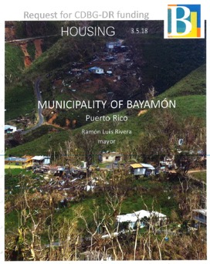
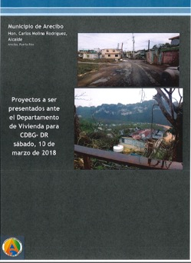
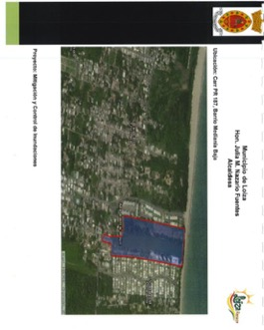
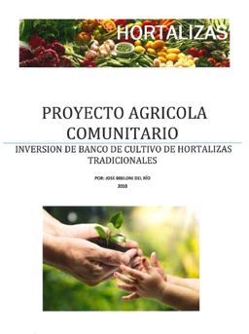
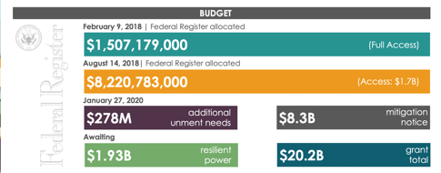
Summary of CDBG-DR financing
TOTAL ESTIMATE
20.2 BILLION
Notes:
Dennis

Slide 6
CDBG-DR Overall Benefit Requirement
HUD requires that 70% of funds be used primarily to benefit low- and moderate income (LMI) individuals; but the Secretary may waive this upon finding of compelling need
Compliance depends on the activity – it can be done on an individual or areawide basis.
Ex: Compare the renovation of a home to a repair of a community center.
Note: applies to the grant as a whole, not each program

Slide 7
Overview – Eligible Activities
Funds must be used for:
“…necessary expenses related to disaster relief, long-term recovery, and restoration of infrastructure, housing, and economic revitalization…”
Address disaster-related impacts
CDBG eligible activities
Activities that meet a National Objective
Demonstrate tie to the disaster
Document how it is addressing a disaster-related impact

Slide 8
Overview – Eligible Activities
Recovery Activities
Housing – Activities that lead to restoring and improving the housing stock
Restoration of Infrastructure – Activities that rebuild or replace impacted infrastructure
Economic Revitalization – Activities that serve to address job losses, impacts to tax revenues, and impacts to business
Planning and Administration – Overall planning and administration of the grant

Slide 9
Relationships of Grantee & Nonprofit
Requirements for a nonprofit depends on the relationship it has with the grantee.
Possible relationships include:
Subrecipient (24 CFR 570.500(c))
Selected by the grantee using specific selection criteria
Has responsibility for programmatic decision making
Is responsible for Federal program requirements
Performance monitored by grantee
Contractor
Competitively procured and provides a specific scope of services
Does not have to be a for-profit or private sector entity – can be a nonprofit

Slide 10
Relationships of Grantee & Nonprofit
Additional relationships include:
Developer
Awarded funds for an affordable housing development ‒
Can be either a for-profit or non-profit entity
Typically organized and/or formed for single purpose or undertaking (e.g., rental or homebuyer project)
Does not have to be a for-profit or private sector developer – can be a nonprofit
Business
Privately- or publicly-held for-profit entity receiving funds as a beneficiary under a program (e.g., business loan program)

Slide 11
Other Relationships of Nonprofit
Other relationships available to nonprofits include:
Subcontractor
Subcontractor to a prime contractor under contract with the grantee
Part of a prime contractor’s team identified in proposal
Part of a prime contractor’s team selected after award of contract
May be well equipped to provide a piece of the services required of contractor (e.g., applicant intake,

Slide 12
Relationships of Grantee & Nonprofit
 | Subrecipient | Contractor/Developer
Selection Process | Designated by the grantee via an application or other selection method | Selected by a competitive procurement process in accordance with 2 CFR 200
Applicability of Requirements | Subject to all applicable administrative, financial and cross-cutting rules | Subject to requirements for the specified scope of work
Monitoring and Performance | Must adhere to written agreement outlining responsibilities Recipient monitors all aspects of program | Must deliver services identified in the contract

Slide 13
Assessing Capacity
Grantee will assess the capacity of the subrecipient or contractor. Assessment may include:
Grant management history (track record)
Prior grantee monitoring reports
Other audits
Staffing
New or experienced
Turnover rate
Program and activity experience
Knowledge of CDBG/CDBG-DR
Experience managing similar programs/activities

Slide 14
Assessing Capacity
Assessment may also include:
Financial and Tracking Systems
Adherence to uniform standards (2 CFR 200)
Invoice and payment functionality
Experience in handling program income (if applicable)
2 CFR 200 audit reports
Note: Payment is Made as Reimbursement Only

Slide 15
Assessing a Sub’s Capacity
Areas of focus within the subrecipient organization that are examined include but are not limited to:
Staffing/Headcount
Internal controls
Policies and procedures
Grants Management
Accounting
Procurement
Record Retention
Prior Grants Management Experience
Results of Federal and Internal Audits
Fraud, Waste, and Abuse
Reliance on Outside Contractors
Conflict of Interest
Notes:
Big question ..
Does the organization have the capacity to complete the activity as proposed?
Are the activities eligible for funding?
Is it tied to the disaster
Included in the Action Plan
Does it meet a National Objective
Does the activity adequately address an established unmet need in the community?
Has the prospective subrecipient identified all the major tasks that will be involved in carrying out the activity?
Are there any stumbling blocks to halt implementation?

Slide 16
Subrecipient Application
HUD requires grantees to clearly identify the scope of services to be undertaken from the CDBG-DR funds which consider:
Detailed description of the project scope
Tie to the disaster
National Objectives
Preventing Duplication of Benefits
Environmental review
Budget of itemized costs such as:
Project cost (construction, planning)
Activity delivery costs
Administrative costs (general staff time)
Notes:
Activity Delivery Cost (cost to undertake the project, staff time, advertisement
Administrative Cost
general staff time (based upon budget approval)
Are the activities eligible for funding?
Is it tied to the disaster
Included in the Action Plan
Does it meet a National Objective
Does the activity adequately address an established unmet need in the community?
Has the prospective subrecipient identified all the major tasks that will be involved in carrying out the activity?
Are there any stumbling blocks to halt implementation?

Slide 17
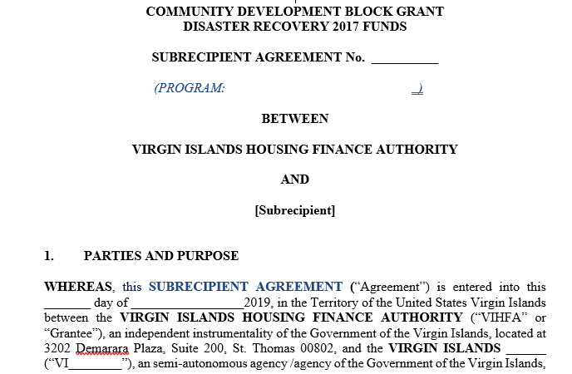
Subrecipient Agreements
HUD CDBG regulations (24 CFR 570.503) require that grantees enter into a formal legal written agreement with each subrecipient before spending any CDBG-DR funds

Slide 18
Other Requirements
Oversight by Grantee
Risk Assessment/Monitoring
Reporting
Documentation/Recordkeeping
Cross-Cutting Requirements

Slide 19
Requirements for Use of Funds
Environmental Review
Labor Standards
Fair Housing & Equal Opportunity
Section 3 Hiring & Training
Procurement & Subrecipient Agmts
Lead Based Paint
Relocation & Acquisition
Accessibility
FFATA (Federal Funding Accountability and Transparency Act)
Cross-cutting federal requirements include but are not limited to:

Slide 20
HUD’s Environmental Review
Analyzes the impacts of a project on the surrounding environment and vice versa
Ensures that HUD-funded projects provide decent, safe, and sanitary housing
Demonstrates compliance with up to 17 federal environmental laws and authorities, like protecting endangered species
A public document that encourages public participation

Slide 21
HUD’s Environmental Review
Grantees must not spend a dime until the environmental review is complete and they have received an approved Request for Release of Funds (form 7015.16) when it’s required. Neither applicant nor partners in the process are allowed to commit or spend HUD or non-HUD funds on physical activities, including acquisition, until the ER process is completed
Any nonprofit or family applying for HUD rebuilding grants (such as from Vivienda) must stop work at the point of application for assistance

Slide 22
DR Environmental Provisions
Some CDBG-DR supplementals include environmental streamlining, allowing a project that has gone through FEMA environmental review to bypass CDBG-DR environmental review
HUD Responsible Entities can adopt a FEMA review if:
The scope of work has not changed
HUD funds are covering the cost share
The grantee notifies HUD in its Request for Release of Funds

Slide 23
Requirements for Use of Funds
Grant and Financial Management
Must comply with all OMB requirements at 2 CFR 200, including:
Financial and internal controls
Procurement
Independent cost estimates
Accounting procedures
Cost principles and audit requirements
Timely expenditure of funds including program income
Performance measures
Written agreements
HUD requires grantees to prepare financial forecasts by program to project expenditures and measure progress

Slide 24
“Necessary and Reasonable”
It is a general tenet of federal assistance that costs attributable to a grant must be both necessary and reasonable
Many cross-cutting federal requirements are codified at 24 CFR Part 200
These regulations ensure orderly administration of grants and protection of taxpayer dollars
The single most prevalent monitoring finding against HUD CDBG grantees? Failure to keep sufficient written records
Absent documentation, there is no proof that an expenditure was eligible, necessary, and reasonable.
Notes:
Activity Delivery Cost (cost to undertake the project, staff time, advertisement
Administrative Cost
general staff time (based upon budget approval)
Are the activities eligible for funding?
Is it tied to the disaster
Included in the Action Plan
Does it meet a National Objective
Does the activity adequately address an established unmet need in the community?
Has the prospective subrecipient identified all the major tasks that will be involved in carrying out the activity?
Are there any stumbling blocks to halt implementation?

Slide 25
Resources
CDBG-DR Puerto Rico Website:
http://www.cdbg-dr.pr.gov/en/
CDBG-DR Website at HUD Exchange:
https://www.hudexchange.info/programs/cdbg-dr/
CDBG Regulations at 24 CFR 570:
http://www.ecfr.gov/cgi-bin/text-idx?tpl=/ecfrbrowse/Title24/24cfr570_main_02.tpl

Slide 26
Panel Session
Michelle Sugden-Castillo, Enterprise Community Partners
Elizabeth Colón Rivera, Ponce Neighborhood Housing Services
Carmen Cosme, OneStop

Slide 27
Q & A

